Slide 1
CO2013A/CO3013A
Web Technologies Week 2

Slide 2
Outline for today
Brief announcements...
The cascade and introducing the DOM
… including leftover slides from lecture 1
Revise the old CSS with an example using the flag exercise
A solution to “Task 3”
CSS positioning

Slide 3
Reminder
Don’t forget to sign up for your project groups!!
Email me before next week’s lecture…

Slide 4
Have you decided upon your project group? (Deadline for self-made groups is next week...)
Yes
No
Notes:
setup groups.ppv

Slide 5
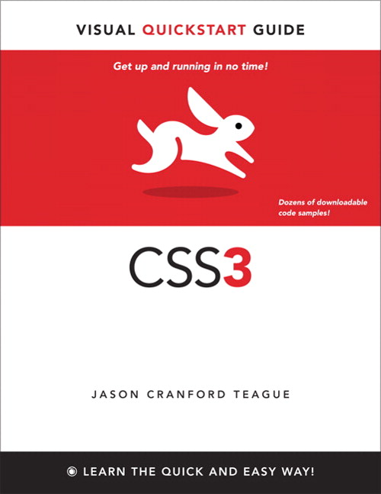
CSS3: Chapters 1~8
Ch1 – CSS intro
Ch2 – HTML5
Ch3 – CSS basics
Ch4 – CSS selectors
Ch5 – Font properties
Ch6 – Test properties
Ch7 – Colour & background
Ch8 – Lists and tables

Slide 6
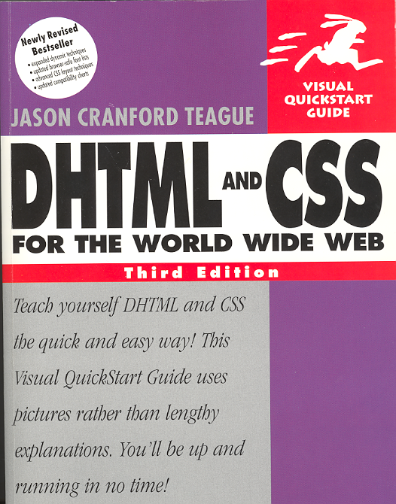
Reading: DHTML&CSS: Chapters 1–8
Table 1.1 (page 7) CSS Properties
Property | What you control
Font | Letter form, size, boldface, italic | Chapter 3
Text | Kerning, leading, alignment, case | Chapter 4
Background | Behind the page or behind a single element on the page | Chapter 5
Border & Margin | Margins, padding, borders, width, height | Chapter 5
Interface | Bullets, indentation, mouse pointer, scroll bars | Chapter 8
Colour | Borders, text, bullets, rules, backgrounds | Chapters 4 and 5

Slide 7
How much of the reading have you done?
0% (none of it)
33% (about a third)
50% (half)
67% (most of it)
100% (all of it)
What reading?
I got the book...
I looked at the book...
What book?
Notes:
reading progress.ppv

Slide 8
CSS
Starting from last week’s leftover stuff…

Slide 9
So which of these are legal CSS syntax?
1. padding:10px;
2. padding:10px 10px;
3. padding:10px 10px 10px;
4. padding:10px 10px 10px 10px;
5. padding:0;
6. padding-width:0px;
Notes:
padding.ppv

Slide 10
Which font-family is the right way to give a typewriter effect font?
Courier, Courier New;
Courier, Courier New, typewriter;
Courier, Courier New, fixed;
Courier, Courier New, monospace;
Courier, "Courier New", monospace;
Courier, "Courier New", fixed;
monospace, Courier, "Courier New";
mono, Courier, "Courier New";
typewriter, Courier, "Courier New";

Slide 11
Why use CSS?
Separating style from information means the info is available to
The biggest “blind user” of the web
All other users who don’t particularly need to see how it looks in order to use it

Slide 12
Who/what is the biggest “blind” consumer of web content?
Blind or partially-sighted people
Google
Bing
Yahoo
Wikipedia
Software
RNIB

Slide 13
Why use CSS?
E.g. “web standards” pages include amazon.co.uk, bbc.co.uk, johnlewis.com, dabs.com, primark.co.uk, tkmaxx.co.uk etc etc...
But not wikipedia.org, StudySpace, StudentSpace
How can you tell?
View Source & dig...
Use Firefox and the Web Developer Extensions: CSS → Disable Styles... Or Opera: View→Handheld

Slide 14
Selectors
You’ve met the CSS1 & CSS2 ones before
Selecting elements by name, e.g.
p {font-family: "Comic Sans", Sans-serif}
Selecting elements by class, e.g.
p.error {font-weight:bold; color:red;}
Selecting an element by its ID, e.g.
p#first {font-style:italic;}
Selecting elements by pseudo-classes, e.g.
a:hover {text-decoration:underline;}
CSS3 defines many more
http://www.w3.org/TR/css3-selectors/#selectors
Specificity gives priority amongst matching rules
http://www.w3.org/TR/css3-selectors/#specificity
Easier explanation: specificity wars ~Star Wars ;-)

Slide 16
Applying styles selectively
Selectors specify where to apply the style:
el {…} applies the style to all <el>…</el>
E.g. p {margin:0;} applies to all <p> elements
el.class {…} only to <el class="class">
E.g. p.top {margin-top:0;} applies to <p class="top"> but not <p> or <p class="bot"> nor <em class="top">
.class {…} apply to all elements with class="class"
E.g. .extLink {color:red;} applies to <a class="extLink"> and <p class="extLink">
HTML elements can also use a list of classes: <el class="c1 c2 …"> (space-separated) allows CSS rules el.c1 and el.c2 to apply and also things like el.c1.c2 (except IE has bugs…)

Slide 17
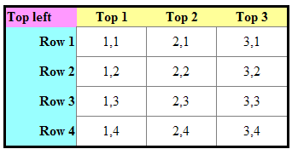
Example (url or Thimble)
<head><style type="text/css"> .first {text-align:right; background-color:#9ff;} .top {text-align:center; background-color:#ff9;} .first.top {text-align:left; background-color:#f9f;} </style></head> <body><table> <tr> <th class="first top">Top left</th> <th class="top">Top 1</th> ... </tr> <tr> <th class="first">Row 1</th> <td>1,1</td> ... </tr> <tr> <th class="first">Row 2</th> <td>1,2</td> ... </tr> ... </table></body>

Slide 18
What’s the least specific selector?
#banana (ID selector)
p (element selector)
* (universal selector)
.banana (class selector)
div p (descendent selector)
div > p (child selector)
div + p (adjacent selector)
a:hover (pseudo-class selector)

Slide 19
Applying styles unselectively
* {…} universal selector
Selects everything (in that context).
E.g. * {visibility:hidden;}
<body> <div> <h1>...</h1> <p>...</p> <h2>...</h2> <ul><li>...</li></ul> </div> <div> <p>...</p> </div> </body>
Firefox: Web Developer extension: Edit CSS, try http://staffnet.kingston.ac.uk/~ku13043/WebTech/

Slide 20
What’s more specific than * but less specific than anything else?
#banana (ID selector)
p (element selector)
* (universal selector)
.banana (class selector)
div p (descendent selector)
div > p (child selector)
div + p (adjacent selector)
a:hover (pseudo-class selector)

Slide 21
Applying styles selectively
div,p {…} grouped selectors
E.g. CSS comma-separated rules that apply to both p and div
<div>Blah<p>Para. inside a div.</p>blah</div>
div,p {border:1px solid red;}
Notes:
Edit CSS on http://staffnet.kingston.ac.uk/~ku13043/WebTech/

Slide 22
What’s more specific than p but less specific than anything else?
#banana (ID selector)
p (element selector)
* (universal selector)
.banana (class selector)
div p (descendent selector)
div > p (child selector)
div + p (adjacent selector)
a:hover (pseudo-class selector)

Slide 23
Example (classes)
<head><style type="text/css"> th {text-align:right; background-color:#9ff;} .top th {text-align:center; background-color:#ff9;} .top .first {text-align:left; background-color:#f9f;} </style></head> <body><table> <tr class="top"> <th class="first">Top left</th> <th>Top 1</th> ... </tr> <tr> <th>Row 1</th> <td>1,1</td> ... </tr> <tr> <th>Row 2</th> <td>1,2</td> ... </tr> ... </table></body>

Slide 24
What’s more specific than .banana and hence the most specific single selector?
#banana (ID selector)
p (element selector)
* (universal selector)
.banana (class selector)
div p (descendent selector)
div > p (child selector)
div + p (adjacent selector)
a:hover (pseudo-class selector)

Slide 25
Example (IDs)
<head><style type="text/css"> th {text-align:right; background-color:#9ff;} #top th {text-align:center; background-color:#ff9;} #first {text-align:left; background-color:#f9f;} </style></head> <body><table> <tr id="top"> <th id="first">Top left</th> <th>Top 1</th> ... </tr> <tr> <th>Row 1</th> <td>1,1</td> ... </tr> <tr> <th>Row 2</th> <td>1,2</td> ... </tr> ... </table></body>

Slide 26
Applying styles selectively
div p {…} contextual selector
E.g. applies only to p inside a div (it's in the div context)
Also known as a “descendant” selector.
Because the document is a tree and div p means p is a descendant (child, grandchild etc.) of div
<div>Blah<p>Para. inside a div.</p>blah</div>
<p>Blah<div>Para. inside a div.</div>blah</p>
div
p

Slide 27
If any, how many <p> would div p select?
<p>Para. 1 outside a div.</p> <div> <p>Para. 2 inside a div.</p> <p>Para. 3 inside a div.</p> <p>Para. 4 inside a div.</p> </div>
0
1
2
3
4
5

Slide 28
If any, how many <p> would div,p select?
<p>Para. 1 outside a div.</p> <div> <p>Para. 2 inside a div.</p> <p>Para. 3 inside a div.</p> <p>Para. 4 inside a div.</p> </div>
0
1
2
3
4
5

Slide 29
If any, how many elements would div,p select?
<p>Para. 1 outside a div.</p> <div> <p>Para. 2 inside a div.</p> <p>Para. 3 inside a div.</p> <p>Para. 4 inside a div.</p> </div>
0
1
2
3
4
5

Slide 30
Applying styles selectively
div > p {…} the child elector
E.g. CSS rule(s) that apply only to p that is an immediate child of div
I.e. div > p would select the 1st <p>.
<div> <p>Para. 1 inside a div.</p> <p>Para. 2 inside a div.</p> <p>Para. 3 inside a div.</p> </div>

Slide 31
Applying styles selectively
li + li {…} the adjacent selector
E.g. CSS rule(s) that apply to only li that is adjacent to another li
A bad way to “zebra stripe”: li {background-color:white;} li + li {background-color:gray;} li + li + li {background-color:white;} li + li + li + li {background-color:gray;} li + li + li + li + li {background-color:white;} li + li + li + li + li + li {background-color:gray}

Slide 32
Being specific: IDs
An ID is very specific – one element only
E.g. <div id="header">...</div> <div id="main-content">...</div> <div id="footer">...</div>
NB: ID attribute value must be unique
Then if you wanted
Grey borders all around and
a logo in the header,
a white background behind the content and
a gray background behind the footer
div {border: thick solid gray;} #header {background-image: /* stuff! */ ;} #main-content {background-color: white;} #footer {background-color: gray;}

Slide 33
Being specific: class names
A class is quite specific – one or many from a set of elements
E.g. <ul id="nav"> <li><a href="shop1.htm">... <li class="promo"><a href="shop2.htm">... <li><a href="shop3.htm">... <li class="promo"><a href="shop4.htm">... <li><a href="shop5.htm">... </ul>

Slide 34
Which selector(s) make the promo <li> elements red? (test)
<ul id="nav"> <li><a href="shop1.htm">... <li class="promo"><a href="shop2.htm">... <li><a href="shop3.htm">... <li class="promo"><a href="shop4.htm">... <li><a href="shop5.htm">... </ul>
#promo {color:red;}
.promo {color:red}
li.promo {color:red}
ul li.promo {color:red}
ul > li.promo {color:red}
li.promo + li {color:red}

Slide 35
The cascade
<style type="text/css">
body{color:blue;}
h1{font-style: italic;}
p{text-decoration: underline;}
.my {font-size: 150%;}
</style>
<body>
<h1>Simple</h1>
<p>A <span class="my">big </span> example</p>
<body>
<h1>
<p>
"Simple"
"A "
<span>
"example"
"big"
Notes:
Style is inherited … it propagates from parent to child through the tree that is the HTML document.
The <body> is the top of the tree so all style cascades from there.

Slide 36
A quick exercise
<style type="text/css">
body{color:blue;}
p{text-decoration: underline;}
</style>
<body>
<p>A <span style="color: red; text-decoration: none;"> colourful</span> example</p>
<body>
<p>
"A "
<span>
"example"
"colourful"
Notes:
Style is inherited … it propagates from parent to child through the tree that is the HTML document.
The <body> is the top of the tree so all style cascades from there.

Slide 37
What style gets applied?
Default: Browser style sheet.
Elements inherit some style through the cascade.
CSS rules are applied according to their specificity:
Inline style is very specific.
E.g. <p style="color:blue;" class="first" id="special">What colour text?</p>
ID rules are more specific than classes.
E.g. p#special {color:red;}
Classes are more specific than element selectors.
E.g. p.first {color:green;}
Element selectors are more specific than the browser
E.g. p {color:yellow;}
Compound selectors combine specificity.
E.g. body p#special {color:orange;}

Slide 38
Another quickie (url)
<html>
<head><style type="text/css">
p {color:red;}
p.that {color:blue;}
p#this {color:green;}
body p#this {color:orange;}
</style></head>
<body>
<p id="this" class="that">
What's the colour of the text?
</p>
</body>
</html>

Slide 39
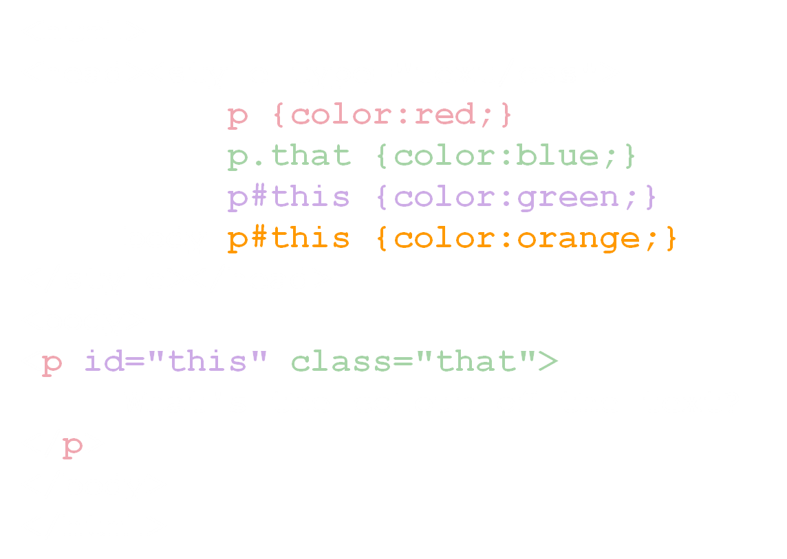
What will be the colour of the text?
Black
Red
Blue
Green
Orange
White

Slide 40
Another quickie (url) – answer:
<html>
<head><style type="text/css">
p {color:red;}
p.that {color:blue;}
p#this {color:green;}
body p#this {color:orange;}
</style></head>
<body>
<p id="this" class="that">
What's the colour of the text?
</p>
</body>
</html>
A: Orange … the ID selector is most important and the descendant version is even more-so!

Slide 41
DOM tree
table
tr
tr
tr
th
th
th
th
th
tr
tr
tr
th
tr
tr
tr
Top left
Top 1
Top 2
Top 3
Row 1
1,1
2,1
3,1
Row 2
1,2
2,2
3,3

Slide 42
DOM: Example (url) with CSS3 selectors (Thimble)
<head><style type="text/css"> th {background-color:#9ff;text-align:right;} tr:first-child th {background-color:#ff9;text-align:center;} tr:first-child th:first-child {background-color:#f9f;text-align:left;} </style></head> <body><table> <tr> <th class="first top">Top left</th> <th class="top">Top 1</th> ... </tr> <tr> <th class="first">Row 1</th> <td>1,1</td> ... </tr> <tr> <th class="first">Row 2</th> <td>1,2</td> ... </tr> ... </table></body>

Slide 43
From exercise 1: A simple flag
Skip fwd.
Consider the flag of Honduras:
Simple 3 table cells layout but the stars cannot easily be drawn using HTML.

Slide 44
HTML table
<table> <tr class="blue"><td></td></tr> <tr id="middle"><td></td></tr> <tr class="blue"><td></td></tr> </table>
Two blue lines … classes!
Q: What's the CSS selector?
A: tr.blue { … }
One unique middle row … ID!
Q: Selector?
A: tr#middle { … }

Slide 45
HTML table & CSS
<table> <tr class="blue"><td></td></tr> <tr id="middle"><td></td></tr> <tr class="blue"><td></td></tr> </table>
tr.blue { background-color:#0B51A1; }
Empty cells have no size ☹
Make the cells bigger! Give them a width and height via CSS
td { width: 516px; height:86px; }

Slide 46
HTML table & CSS
<table> <tr class="blue"><td></td></tr> <tr id="middle"><td></td></tr> <tr class="blue"><td></td></tr> </table>
The middle row is white and contains the stars …
tr#middle { background-color: white; }
Create an image for the stars:

Slide 47
HTML table & CSS
<table> <tr class="blue"><td></td></tr> <tr id="middle"><td></td></tr> <tr class="blue"><td></td></tr> </table>
Add the image to the background
tr#middle { background-image: url(stars.gif); background-repeat: no-repeat; background-position: center center; }

Slide 48
HTML table & shorter CSS
<table> <tr class="blue"><td></td></tr> <tr id="middle"><td></td></tr> <tr class="blue"><td></td></tr> </table>
Add the image to the background
tr#middle { background: white url(honduras-stars.gif) no-repeat center center; }
OR
Add the image to the foreground by modifying the table…

Slide 49
Alternative: HTML table + <img>
<table> <tr class="blue"><td></td></tr> <tr id="middle"><td>
<img src="stars.gif" /> </td></tr> <tr class="blue"><td></td></tr> </table>
CSS: Centre the stars? Many ways…
Positioning? Is the image bigger than the row?
<center> tag? Old-fashioned & invalid!
Margin? Padding? Possible…
Easiest! tr#middle { text-align: center; }
Invalid! What's missing?

Slide 50
Style the flag…
Add a border to make the white space stand out:
table {border: 1px solid black; }
Dodgy!
More white space →
Collapse those borders! CSS!!
border-collapse: collapse;

Slide 52
Centring the table?
Easy-peasy!
Provided the browser is in “standards” mode.
“Margin trick”
table { margin-left:auto; margin-right:auto; }

Slide 53
(url)

Slide 54
How many class or ID names do I need for the Spanish flag?
(middle?)
(red & yellow?)
(top, middle & bottom?)
(top, middle, bottom & picture?)
Notes:
spanish flag.ppv

Slide 55
Spanish flag CSS
1. table { background-color:red; } tr#middle { background-color:yellow; } tr#middle td { padding-left:20%; } | 2. tr.red { background-color:red; } tr#yellow { background-color:yellow; } tr#yellow td { padding-left:20%; }
3. tr#top,tr#bottom { background-color:red; } tr#middle { background-color:yellow; } tr#middle td { padding-left:20%; } | 4. tr#top,tr#bottom { background-color:red; } tr#middle { background-color:yellow; } tr#picture img { padding-left:20%; }

Slide 56
New stuff…
Sizing & positioning things with CSS

Slide 57
CSS units
px
Screen pixels (e.g. screen may be 1024x768 pixels)
pt
Points ~1/72 of an inch (e.g. this is 20pt text)
ex
Font-relative size: The height of an 'x'.
em
Font-relative size: The width of an 'M'.
%
Relative to the container's size (e.g. font-size: 80% is 80% of the container's font size)
Notes:
Remember:
It’s the outer box that is positioned (using left/top styles)
Margin, border and padding styles allow all four lengths to be set using one statement (usually space-separated as top right bottom left).

Slide 58
Dynamic positioning with style
left & top edges of element
right/bottom are alternatives
position:absolute; relative to window
position:relative; w.r.t container
These are read/write properties
However it’s only possible to read left/top/... from elements that are already positioned.

Slide 59
Positionable layers
<div> is the best container as it has no style.
Styles:
visibility, display – set the <div>'s visibility
left & top or bottom & right – position
They all default to zero or ‘auto’
background-color
background-color: transparent; for see-thru!
background-image
Use margin, padding and border carefully.
Box model…

Slide 60
Positioning elements with CSS
Ordinary elements default to CSS style position:static and are placed in the document flow.
Positioned elements can be either absolutely or relatively positioned:
position: relative
relative to where it would otherwise be
position: absolute
with respect to the nearest ancestor containing element

Slide 61
Relative positioning (url)
position: relative
relative to the unpositioned flow
E.g.
<div style="position: static;
border-color: red; border-style: dashed;">
<div style="position: relative;
left: 0px; top: 0px; border-color: green;"> A relatively positioned element...</div>
<div style="position: relative;
left: 0px; top: 0px; border-color: blue;">
Another relatively positioned element</div>
</div>

Slide 62
Absolute positioning #1 (url)
position: absolute;
w.r.t the parent positioned element (which in this case is the <body>!)
<div style="position: static;
border-color: blue; border-style: dashed;">
<div style="position: absolute;
left: 0px; top: 0px; border-color: blue;"> A relatively positioned element...</div>
<div style="position: absolute;
left: 0px; top: 0px; border-color: blue;">
Another relatively positioned element</div>
</div>

Slide 63
Absolute positioning #2 (url Thimble)
position: absolute;
w.r.t the parent positioned element
E.g.
<div style="position: static;
border-color: red; border-style: dashed;">
<div style="position: absolute;
left: 0px; top: 0px; border-color: green;"> A relatively positioned element...</div>
<div style="position: absolute;
left: 0px; top: 0px; border-color: blue;">
Another relatively positioned element</div>
</div>

Slide 64
Fixed positioning (url Thimble)
position: fixed;
w.r.t the browser window or frame
New in CSS2:
Unsupported in Windows ≤ IE6
Works in Mozilla, Opera, IE5 Mac, IE7+
If you are forced to care about IE6, some JavaScript workarounds exist…
E.g. this example

Slide 65
Summary: CSS positioning
position: static;
elements can't be moved from their default position
position: relative; (file1)
relative to the position within the document flow the element would otherwise take.
position: absolute; (file2 file3)
top/left bottom/right relative to the nearest surrounding positioned container (usually the <body> or surrounding positioned <div>) outside the document flow.
position: fixed; (file4 broken in IE6!)
Fixed with respect to the window (~frame sidebar)
New in CSS2: Mozilla, Opera, IE5 Mac, IE7+.
Notes:
Remember:
It’s the outer box that is positioned (using left/top styles)
Margin, border and padding styles allow all four lengths to be set using one statement (usually space-separated as top right bottom left).

Slide 66
IE & W3C CSS box model (url)
top
left
Margin space (transparent)
Content space
height
width
Padding space (background-color)
Border space (border-color; border-style)
right
bottom
Notes:
Remember:
According to the CSS2 box model it's the element that is positioned including any padding. [left/top indicate where a child element would be put!]
Margin./border/padding aren't compliant in NS4!
Unfortunately MS implemented a different model in IE5 whereby the element that's position is still width/height in size but the border is included inside the element (so the content space is reduced by the border amount).
This is illustrated by a page on my WebTech home page http://king-maths:8080/~James/WebTech/BoxModel/positioning.html
Rumour has it that IE6 reverses this decision in it's old-fashioned 'quirks' rendering mode but restores it in its 'strict' mode!
CSS3 (IE for Mac is written by its author!) includes new style attributes to select the box model - Mozilla also, but different (proprietary) names.
Margin, border and padding styles allow all four lengths to be set using one statement (usually space-separated, ordered clockwise from the top: top right bottom left).

Slide 67
IE’s ‘Traditional’ box model (url)
top
left
Margin space (transparent)
Content space
height
Padding space (background-color)
Border space (border-color; border-style)
width
right
bottom
Notes:
Remember:
According to the CSS2 box model it's the element that is positioned including any padding. [left/top indicate where a child element would be put!]
Margin./border/padding aren't compliant in NS4!
Unfortunately MS implemented a different model in IE5 whereby the element that's position is still width/height in size but the border is included inside the element (so the content space is reduced by the border amount).
This is illustrated by a page on my WebTech home page http://king-maths:8080/~James/WebTech/BoxModel/positioning.html
Rumour has it that IE6 reverses this decision in it's old-fashioned 'quirks' rendering mode but restores it in its 'strict' mode!
CSS3 (IE for Mac is written by its author!) includes new style attributes to select the box model - Mozilla also, but different (proprietary) names.
Margin, border and padding styles allow all four lengths to be set using one statement (usually space-separated, ordered clockwise from the top: top right bottom left).

Slide 68
Box model differences
Stick with the W3C box model for consistency…
Notes:
Get CSS layouts working in IE and you might be fooling yourself about Mozilla, Opera, Safari, mobile compatibility…

Slide 69
CSS box model (url)
Width is for the content, e.g. if the element is <div style=" width:300px; border: 20px; padding: 30px; ">
Total width = 300 + 2×20 + 2×30 = 400px
Content width = 300px
IE5.5 included the padding and border inside the <div> so
Total width = 300px
Content width = 300 – 40 – 60 = 200px
IE6+ reproduces this feature in ‘Quirks’ mode E.g. XHTML document with anything except a valid DOCTYYPE on the 1st line
E.g. an empty line, a space, an invalid DOCTYPE, a comment...
In IE6, an XML prolog <?xml version="1.0"?>

Slide 70
XHTML as valid XML documents
XHTML was (eventually) supposed to replace HTML.
Valid XHTML documents are also valid XML documents
(follow the XML rules)
…as long as the 1st line in the XHTML file is an XML prolog like the following:
<?xml version="1.0" encoding="ISO-8859-1"?>
This tells the XML parser a few things about the document and is mandatory for an XML document
… but browsers are not XML parsers & the XML prolog is optional in XHTML!
This is the XML document encoding. We use a META tag.

Slide 71
So what?
We don't have to bother about it as current browsers except Opera and Mozilla don’t understand XHTML as XML!
Serve an XHTML document as an XML ‘MIME type’ to Internet Explorer <9 and it chokes ☹
The ‘MIME type’ tells the browser what kind of document it is
HTML is ‘text/html’ (url)
XML is ‘application/xml’ (url)
XHTML is ‘application/xhtml+xml’ (url)
See ‘XHTML considered harmful’

Slide 72
So???
Internet Explorer also switches out of ‘standards mode’ when an XML prolog is present.
It’s in ‘standards mode’ only if a valid DOCTYPE is the 1st line of the document.
See ‘DOCTYPE switching’ online for lots of detail…
IE‘s ‘standards’ vs ‘quirks’ mode affects a few things…
You really want ‘standards’ mode for consistency & ease of development.
Make sure the 1st line of any XHTML document is always a valid & complete DOCTYPE

Slide 73
Participant Scores
1200 | Participant 216214
1000 | Participant 21458E
1000 | Participant 214618
900 | Participant 21621F
900 | Participant 21621E
800 | Participant 2144D8
800 | Participant 2161EF
800 | Participant 214593
800 | Participant 21458C
800 | Participant 2160C1

