Slide 1
CO2013/CO3013
Web Technologies Week 3

Slide 2
Outline for today
Group project
CSS positioning
JavaScript “Hello World!”

Slide 3
Group Project
This year: Minesweeper (e.g. see Wikipedia?)

Slide 4
Have you decided upon your project group? (Deadline for self-made groups was today...)
Yes
No
Notes:
setup groups.ppv

Slide 5
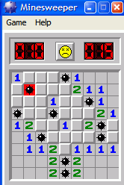
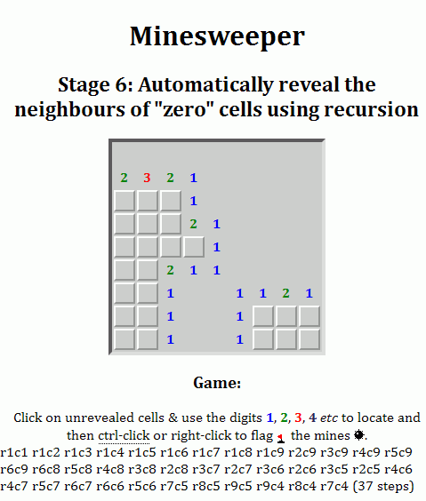
Group project
Previously: Pacman, Breakout, Simon Says, Sliding Blocks, Snake
Simple Minesweeper game
See the project specification document
Groups of 2-4 members
Did you sign up?
If not you get a team ~at random some time this week…
Project is broken down into “development stages” as a suggested approach to its design …
Notes:
http://lms.kingston.ac.uk/bbcswebdav/courses/CO2013-A_SEM1/Projects/minesweeper/mines-stage6a.html

Slide 6
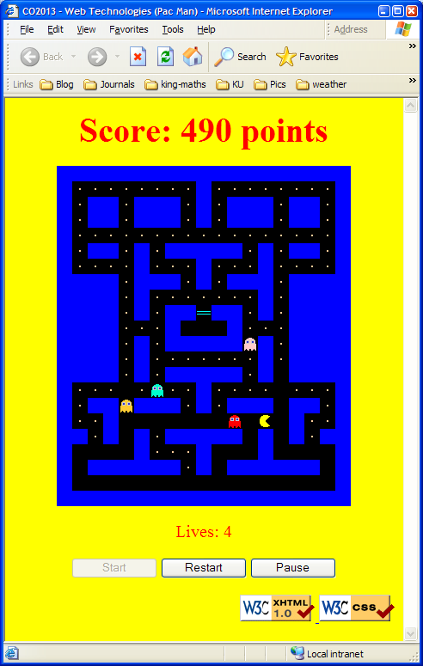
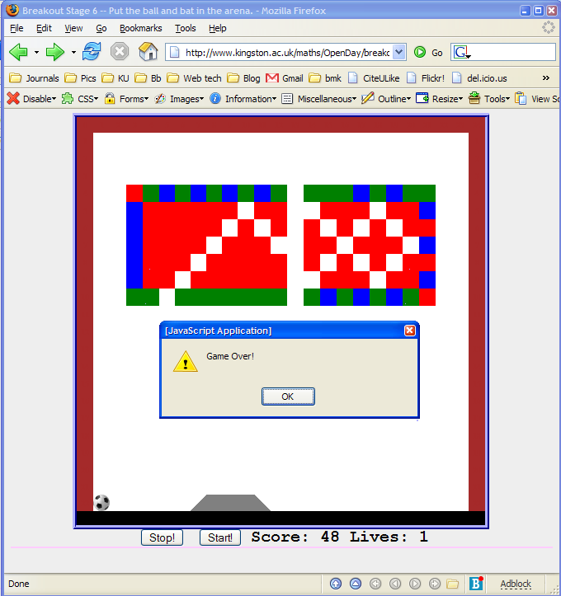
Group project: Online examples
Pacman
Breakout

Slide 7
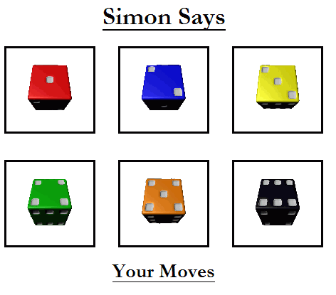
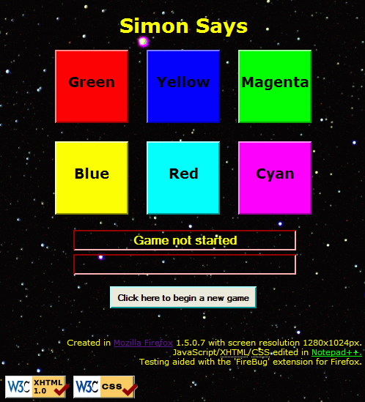
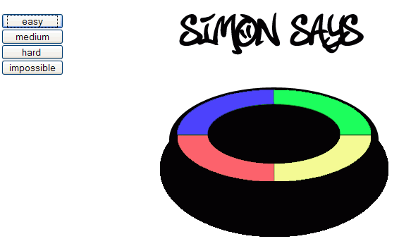
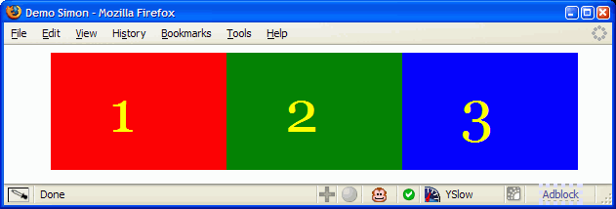
“Simon Says”

Slide 8
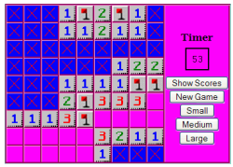
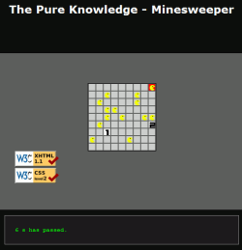
Minesweeper

Slide 9
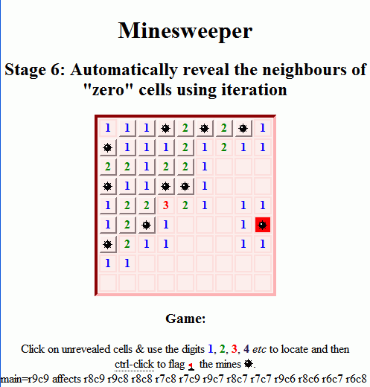
Minesweeper

Slide 10
Mine is a boring example!
The project spec. document is flexible:
your group’s can be more interesting, better looking, better … better!
There are loads of examples online … use them for inspiration but don’t copy them!
You’re expected to document your work with a write-up … anything you don’t include in your report or can’t explain in the January “viva” meeting will be considered poorly ☹

Slide 11
Working together…
Working together is good.
Mandatory for the ‘group project’!
But copying someone else’s work (plagiarism) is not good …
whether it’s a part of your workfolder or your project.
I, the Faculty, the University & KUSU treat it seriously … so should you!

Slide 12
“I would remove the group task. [Becasue some people do no work in the group (and still get the marks) and they then copy the Workfolder from others. So potentially someone who's done no work can get a higher mark than someone who (hasn't copied) and done lots of work.]” What are the TWO best ways to avoid this ?
Get rid of group work.
Let us give each-other marks.
Give more marks for group work.
Make us present the work we did.
Make us write about the work we did.
Break the work down into individual tasks.
Groups should not leave it ‘til the last minute.
Groups should have a leader.
Groups should have records of group meetings.

Slide 13
“There was to many deadlines which was near my other modules deadlines, which i found difficult. Also for the group project I would have set deadlines for each stage”
Good or
Bad idea?

Slide 14
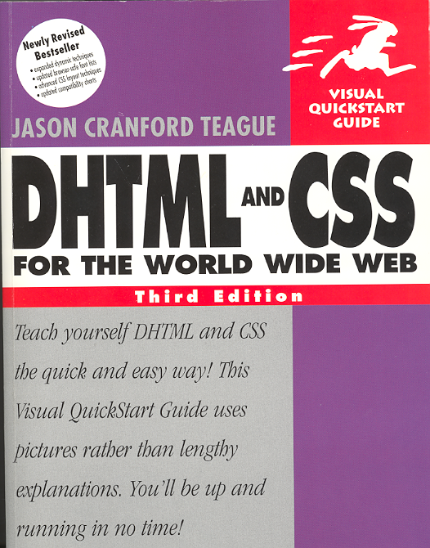
Reading: DHTML&CSS: Chapters 1–8
Table 1.1 (page 7) CSS Properties
Property | What you control
Font | Letter form, size, boldface, italic | Chapter 3
Text | Kerning, leading, alignment, case | Chapter 4
Background | Behind the page or behind a single element on the page | Chapter 5
Border & Margin | Margins, padding, borders, width, height | Chapter 5
Interface | Bullets, indentation, mouse pointer, scroll bars | Chapter 8
Colour | Borders, text, bullets, rules, backgrounds | Chapters 4 and 5
Positioning | Exact placement on the screen | Chapter 6
Display & Visibility | Whether one element appears and how much of it is showing | Chapter 7

Slide 15
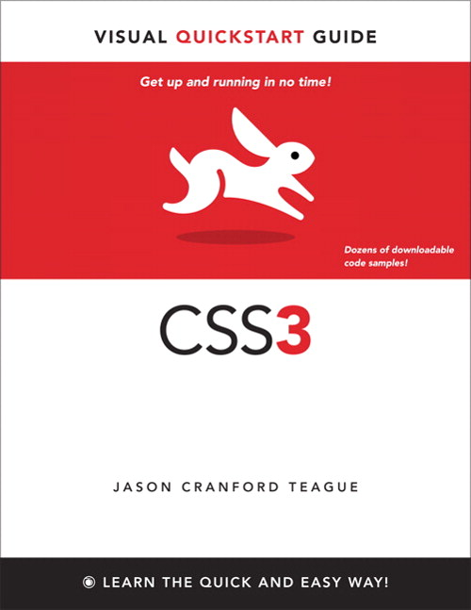
CSS3: Chapters 10&11
Ch1 – CSS intro
Ch2 – HTML5
Ch3 – CSS basics
Ch4 – CSS selectors
Ch5 – Font properties
Ch6 – Test properties
Ch7 – Colour & background
Ch8 – Lists and tables
Ch10 – Box properties
Ch11 – Visual formatting properties

Slide 16
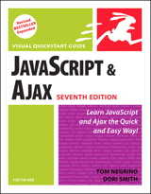
For next week: JavaScript
“JavaScript for the WWW”
Chapters 1—3 introduce JavaScript…
“Head First JavaScript”
Chapters 1—2
“Learning JavaScript”
Chapters 1—3
Or
Gosselin “JavaScript 3e”
Ch1 introduces JS, Ch2 introduces JS variables etc.
“JavaScript A programmer’s companion”
chapters 1~5.
ETC…

Slide 17
How much of the reading have you done?
0% (none of it)
33% (about a third)
50% (half)
67% (most of it)
100% (all of it)
What reading?
Notes:
reading progress.ppv

Slide 18
Quickie from last week: Specificity (url)
<html>
<head><style type="text/css">
body {color:black;}
body p#this {color:orange;}
p#this {color:green;}
p.that {color:blue;}
p {color:red;}
</style></head>
<body>
<p id="this" class="that">
What's the colour of the text?
</p>
</body>
</html>
MozillaThimble (edit)

Slide 19
What colour is the text?
red
green
blue
orange
black
<html>
<head><style type="text/css">
body {color:black;}
body p#this {color:orange;}
p#this {color:green;}
p.that {color:blue;}
p color:red;}
</style></head>
<body>
<p id="this" class="that">
What's the colour of the text?
</p>
</body>
</html>
Notes:
orange.ppv

Slide 20
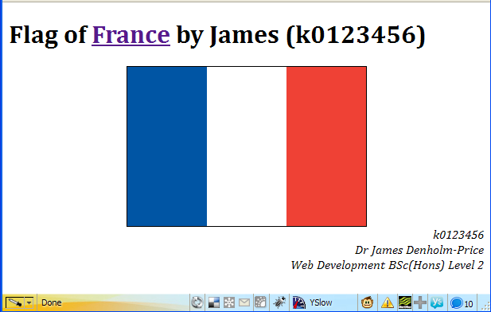
What do I need for France’s flag?
position: absolute;
position: relative;
position: static;
position: fixed
<div id="wrap"> <div id="blue"></div> <div></div> <div id="red"></div> </div>

Slide 21
Can I do without the IDs? (Pick one.)
No.
Yes – use the child selector “>”.
Yes – use the adjacent selector “+”.
Yes – use the nth-child selector.
<div id="wrap"> <div></div> <div></div> <div></div> </div>

Slide 22
How many class or ID names do I need for the Spanish flag? (Pick one.)
(middle?)
(red & yellow?)
(top, middle & bottom?)
(top, middle, bottom & picture?)
Notes:
spanish flag.ppv

Slide 23
Spanish flag CSS
1. table { background-color:red; } tr#middle { background-color:yellow; } tr#middle td { padding-left:20%; } | 2. tr.red { background-color:red; } tr#yellow { background-color:yellow; } tr#yellow td { padding-left:20%; }
3. tr#top,tr#bottom { background-color:red; } tr#middle { background-color:yellow; } tr#middle td { padding-left:20%; } | 4. tr#top,tr#bottom { background-color:red; } tr#middle { background-color:yellow; } tr#picture img { padding-left:20%; }

Slide 24
New stuff…
Sizing & positioning things with CSS

Slide 25
CSS units
px
Screen pixels (e.g. screen may be 1024x768 pixels)
pt
Points ~1/72 of an inch (e.g. this is 20pt text)
ex
Font-relative size: The height of an 'x'.
em
Font-relative size: The width of an 'M'.
%
Relative to the container's size (e.g. font-size: 80% is 80% of the container's font size)
Notes:
Remember:
It’s the outer box that is positioned (using left/top styles)
Margin, border and padding styles allow all four lengths to be set using one statement (usually space-separated as top right bottom left).

Slide 26
What’s the problem with text sized in px?
It’s inaccessible as it can’t be resized.
It can’t be resized in IE7.
It’s a problem on mobile devices.
Google says it’s a problem.
No problem!
Notes:
http://webaim.org/techniques/fonts/#relative.section

Slide 27
Dynamic positioning with style
left & top edges of element
right/bottom are alternatives
position:absolute; relative to window
position:relative; w.r.t container
These are read/write properties in JavaScript
However it’s only possible to read left/top/... from elements that are already positioned.

Slide 28
Positionable layers
<div> is the best container as it has no style.
Styles:
visibility, display – set the <div>'s visibility
left & top or bottom & right – position
They all default to zero or ‘auto’
background-color
background-color: transparent; for see-thru!
background-image
Use margin, padding and border carefully.
Box model…

Slide 29
Positioning elements with CSS
Ordinary elements default to CSS style position:static and are placed in the “document flow”.
Positioned elements can be either absolutely or relatively positioned:
position: relative
relative to where it would otherwise be
position: absolute
with respect to the nearest ancestor containing element

Slide 30
Relative positioning (url)
position: relative
relative to the unpositioned flow
E.g.
<div style="position: static;
border-color: red; border-style: dashed;">
<div style="position: relative;
left: 0px; top: 0px; border-color: green;"> A relatively positioned element...</div>
<div style="position: relative;
left: 0px; top: 0px; border-color: blue;">
Another relatively positioned element</div>
</div>

Slide 31
Absolute positioning #1 (url)
position: absolute;
w.r.t the ancestor positioned element (“container”) (which in this case is the <body>!)
<div style="position: static;
border-color: blue; border-style: dashed;">
<div style="position: absolute;
left: 0px; top: 0px; border-color: blue;"> A relatively positioned element...</div>
<div style="position: absolute;
left: 0px; top: 0px; border-color: blue;">
Another relatively positioned element</div>
</div>

Slide 32
Absolute positioning #2 (url Thimble)
position: absolute;
w.r.t the ancestor positioned element (“container”)
E.g.
<div style="position: relative; /*container*/
border-color: red; border-style: dashed;">
<div style="position: absolute;
left: 0px; top: 0px; border-color: green;"> A relatively positioned element...</div>
<div style="position: absolute;
left: 0px; top: 0px; border-color: blue;">
Another relatively positioned element</div>
</div>

Slide 33
Fixed positioning (#1 #2 Thimble)
position: fixed;
w.r.t the browser window or frame
New in CSS2:
Unsupported in Windows IE5, IE6
Works in Mozilla, Opera, IE7+ etc.
If you care about IE6, some JavaScript workarounds exist…
E.g. this example

Slide 34
Summary: CSS positioning
position: static;
elements can't be moved from their default position
position: relative; (file1)
relative to the position within the document flow the element would otherwise take.
position: absolute; (file2 file3)
top/left bottom/right relative to the nearest surrounding positioned container (usually the <body> or surrounding positioned <div>) outside the document flow.
position: fixed; (file4 file5 broken in IE6!)
Fixed with respect to the window (~frame sidebar)
New in CSS2: Mozilla, Opera, IE5 Mac, IE7+.
Notes:
Remember:
It’s the outer box that is positioned (using left/top styles)
Margin, border and padding styles allow all four lengths to be set using one statement (usually space-separated as top right bottom left).

Slide 35
E.g. 2 columns next to each-other?
#main {position:relative;}
#main {position:absolute;}
#nav {position:relative;}
#nav {position:absolute;}
#nav {position:fixed;}
#nav {width:38.5%} #main{width:61.5%}
(url Thimble)
Notes:
Edit the CSS in Firefox (Web Developer) or use Thimble

Slide 36
IE & W3C CSS box model (url)
top
left
Margin space (transparent)
Content space
height
width
Padding space (background-color)
Border space (border-color; border-style)
right
bottom
Notes:
Remember:
According to the CSS2 box model it's the element that is positioned including any padding. [left/top indicate where a child element would be put!]
Margin./border/padding aren't compliant in NS4!
Unfortunately MS implemented a different model in IE5 whereby the element that's position is still width/height in size but the border is included inside the element (so the content space is reduced by the border amount).
This is illustrated by a page on my WebTech home page http://king-maths:8080/~James/WebTech/BoxModel/positioning.html
Rumour has it that IE6 reverses this decision in it's old-fashioned 'quirks' rendering mode but restores it in its 'strict' mode!
CSS3 (IE for Mac is written by its author!) includes new style attributes to select the box model - Mozilla also, but different (proprietary) names.
Margin, border and padding styles allow all four lengths to be set using one statement (usually space-separated, ordered clockwise from the top: top right bottom left).

Slide 37
IE’s ‘Traditional’ box model (url)
top
left
Margin space (transparent)
Content space
height
Padding space (background-color)
Border space (border-color; border-style)
width
right
bottom
Notes:
Remember:
According to the CSS2 box model it's the element that is positioned including any padding. [left/top indicate where a child element would be put!]
Margin./border/padding aren't compliant in NS4!
Unfortunately MS implemented a different model in IE5 whereby the element that's position is still width/height in size but the border is included inside the element (so the content space is reduced by the border amount).
This is illustrated by a page on my WebTech home page http://king-maths:8080/~James/WebTech/BoxModel/positioning.html
Rumour has it that IE6 reverses this decision in it's old-fashioned 'quirks' rendering mode but restores it in its 'strict' mode!
CSS3 (IE for Mac is written by its author!) includes new style attributes to select the box model - Mozilla also, but different (proprietary) names.
Margin, border and padding styles allow all four lengths to be set using one statement (usually space-separated, ordered clockwise from the top: top right bottom left).

Slide 38
Box model differences
Stick with the W3C box model for consistency…
Notes:
Get CSS layouts working in IE and you might be fooling yourself about Mozilla, Opera, Safari, mobile compatibility…

Slide 39
CSS box model (url)
Width is for the content, e.g. if the element is <div style=" width:300px; border: 20px; padding: 30px; ">
Total width = 300 + 2×20 + 2×30 = 400px
Content width = 300px
IE5.5 included the padding and border inside the <div> so
Total width = 300px
Content width = 300 – 40 – 60 = 200px
IE6+ reproduces this feature in ‘Quirks’ mode E.g. XHTML document with anything except a valid DOCTYYPE on the 1st line
E.g. an empty line, a space, an invalid DOCTYPE, an XML prolog <?xml version="1.0"?>

Slide 40
XHTML as valid XML documents
XHTML was (eventually) supposed to replace HTML.
Valid XHTML documents are also valid XML documents
(we follow the XML rules)
…as long as the 1st line in the XHTML file is an XML prolog like the following:
<?xml version="1.0" encoding="ISO-8859-1"?>
This tells the XML parser a few things about the document and is mandatory for an XML document
… but browsers are not XML parsers & the XML prolog is optional in XHTML!
This is the XML document encoding. We use a META tag.

Slide 41
So what?
We don't have to bother about it as current browsers except Opera and Mozilla don’t understand XHTML as XML!
Serve an XHTML document as an XML ‘MIME type’ to Internet Explorer and it chokes!
The ‘MIME type’ tells the browser what kind of document it is
HTML is ‘text/html’ (url)
XML is ‘application/xml’ (url)
XHTML is ‘application/xhtml+xml’ (url)
See ‘XHTML considered harmful’

Slide 42
So???
Internet Explorer also switches out of ‘standards mode’ when an XML prolog is present.
It’s in ‘standards mode’ only if a valid DOCTYPE is the 1st line of the document.
See ‘DOCTYPE switching’ online for lots of detail…
IE’s ‘standards’ vs ‘quirks’ mode affects a few things…
You really want ‘standards’ mode for consistency & ease of development.
Make sure the 1st line of any XHTML document is always a valid & complete DOCTYPE
HTML4, XHTML or HTML5 all work...

Slide 43
So how do I ensure IE is in ‘standards’ mode not ‘quirks mode’? (The correct 1st line?) [2]
<?xml version="1.0" encoding="ISO-8859-1"?>
<!DOCTYPE html>
<!DOCTYPE html>
<!DOCTYPE html PUBLIC "-//W3C//DTD XHTML 1.0 Transitional//EN" "http://www.w3.org/TR/xhtml1/DTD/xhtml1-transitional.dtd">
<?xml version="1.0" encoding="ISO-8859-1"?> <!DOCTYPE html PUBLIC "-//W3C//DTD XHTML 1.0 Transitional//EN" "http://www.w3.org/TR/xhtml1/DTD/xhtml1-transitional.dtd">
Notes:
Note the space before 2…

Slide 44
Which of the following as the first 1 or 2 lines of an HTML document gives IE6+ “standards mode”?
<?xml version="1.0" encoding="ISO-8859-1"?> <!DOCTYPE html PUBLIC "-//W3C//DTD XHTML 1.0 Strict//EN" …>
<!DOCTYPE html PUBLIC "-//W3C//DTD XHTML 1.0 Strict//EN" …>
<!DOCTYPE html PUBLIC "-//W3C//DTD XHTML 1.0 Strict//EN" …>
<html>
<html xmlns="http://www.w3.org/1999/xhtml">
Assuming a complete DOCTYPE...
Notes:
IE6 standards mode.ppv

Slide 45
Exercises: Week 1 (hidden slides for you to read...)
Validation & “stylistic rubbish”

Slide 46
Examples from the exercise
What’s stylistic rubbish in HTML4?
<center> tag must go!
<b> and <i> tags must go!
align attributes must go!
border attributes must go!
width/height attributes must go!
Except possibly on <img> tags where they serve a useful purpose…
And don’t ever use a <font> tag!!!

Slide 47
Examples from the exercise
To centre all <h1> headings
There’s only one so use the global h1 selector h1 {text-align:center;}
To right align just the validator images
They’re in a <p> and there’s more than one so identify the <p> with a class or id:
So for a class <p class="valid"> p.valid {text-align:right;}
… and for an ID <p id="valid"> p#valid {text-align:right;}

Slide 48
Examples from the exercise
To centre the <table>
In standards mode (1st line=valid DOCTYPE) IE6 obeys CSS-style margin-auto centring command (see e.g. css-discuss wiki page).
Again, just one table so can use table {margin-left:auto; margin-right:auto;}
margin alone takes 1-4 property values & is a useful shortcut…
To add single-pixel wide borders to the table:
Again, just one table so table {border:1px solid black;} will do the outside.
To get borders around all of the cells on the page td {border: 1px solid black;}
But this makes ‘double borders’, they don’t collapse. To force the collapse add border-collapse to the table rule: table { border:1px solid black border-collapse: collapse; }
(url)
;
What’s wrong with this last CSS rule?

Slide 49
CSS shorthands: font
Font shorthand property
font: style variant weight size family; combines font-style, font-variant, font-weight, font-size, and font-family.
E.g. font: italic /* style */ small-caps /* variant */ bold /* weight */ 150% /* size */ "Arial Black", Arial, Geneva, sans-serif; /*family*/
Generic font name always comes last
E.g. font-family: Arial, sans-serif; NOT font-family: sans-serif, Arial;

Slide 50
CSS shorthands: border
CSS border syntax
border: width style color; is the shorthand
E.g. border: thick ridge #2faced;
border-width, border-style, border-color all take 1 to 4 property values in compass “N, E, S, W” order (empties are copied from the opposite/nearest…)
“Never Eat Shredded Wheat”
“Naughty Elephants Squirt Water”
E.g.
border-width: 1px; “all 4 sides 1px”
border-width: 1px 2px; “1px top, 2px right, 1px bottom and 2px left”
border-width: 1px 2px 3px; “1px top, 2px right, 3px bottom and 2px left (copy)”
border-width: 1px 2px 3px 4px; “1px top, 2px right, 3px bottom and 4px left”
CSS units
E.g. border-right : 1px; NOT border-right : 1 px;

Slide 51
This is the new stuff..
JavaScript

Slide 52
Reading for next week: JavaScript
“JavaScript for the WWW”
Chapters 1—3 introduce JavaScript…
“Head First JavaScript”
Chapters 1—2
“Learning JavaScript”
Chapters 1—3
Or
Gosselin “JavaScript 3e”
Ch1 introduces JS, Ch2 introduces JS variables etc.
“JavaScript A programmer’s companion”
chapters 1~5.
ETC…

Slide 53
The <script> Element
JavaScript programs
run from within a Web page (either an HTML or XHTML document),
code is typed directly into the source (HTML) file or a separate text file,
contained within a Web page are often called scripts.
The <script> tag tells the web browser that the scripting engine must interpret the commands it contains
The element’s contents are the code or src points to a separate file.

Slide 54
Internal JavaScript <script>
The type attribute of the <script> element
Tells browser which scripting language is being used.
type="text/javascript" says the script is JavaScript.
This HTML tells the web browser to interpret JavaScript:
<script type="text/javascript">
…statements
</script>
The script is not visible on the page.
language="javascript" is deprecated in XHTML1
Don’t use it!

Slide 55
External file <script>
The src attribute of the <script> element
Tells browser where to find an external script file.
<script type="text/javascript" src="script.js" >
statements are ignored!
</script>
The element contents are ignored, the attribute points to the file and that is loaded & parsed as if the code were statements inside a <script> element.

Slide 56
Two “Hello world!” examples
<script type="text/javascript" src="script.js" > document.write("Hello world!"); </script>
<script type="text/javascript" src="script.js" > alert("Hello world!"); </script>

Slide 57
This week
Read
“JavaScript for the WWW”
Chapters 1—3 introduce JavaScript…
Or “Head First JavaScript”
Chapters 1—2
Or “Learning JavaScript”
Chapters 1—3
Events is for next week.
Complete week 1 & 2 exercises.
Start week 3 exercises

Slide 58
Next week
JavaScript:
Functions
HTML:
Events.

