Slide 1
CO2013/CO3013
Web Technologies Week 4

Slide 2
Study skills (aka SSS or S³)
Academic Skills Centre
The SEC Study Skills Centre (S³) is available for all levels of students enrolled on courses within the Faculty of Science, Engineering & Computing and School of Surveying & Planning. A group of trained staff and students are available to help students with academic skills such as report writing, presentations, note taking, time management, exam revision, referencing and mathematical skills. The centre provides assistance and advice on draft assignments prior to hand in.
Penrhyn Rd Campus:
Drop-in sessions run during term-time from Monday to Friday 11-3pm in PRJG0004 with a reduced service throughout vacations
Roehampton Vale Campus:
Drop-in sessions run during term-time on Tuesdays from 12-5pm in the Learning Resource Centre (LRC)
sss@kingston.ac.uk

Slide 3
This week’s lab class
Due to a course validation meeting I’ll probably be half-an-hour late for the lab class.
However Dilaksha and Dan won’t be late so please make the most use of the available time...

Slide 4
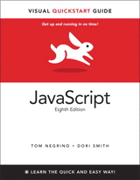
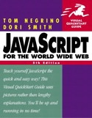
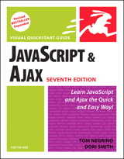
This week’s JavaScript chapters
“JavaScript for the WWW”
Chapters 1—3 introduce JavaScript…
“Head First JavaScript”
Chapters 1—2
“Learning JavaScript”
Chapters 1—3
Or
Gosselin “JavaScript 3e”
Ch1 introduces JS, Ch2 introduces JS variables etc.
“JavaScript A programmer’s companion”
chapters 1~5.
ETC…

Slide 5
How much of the reading have you done?
0% (none of it)
33% (about a third)
50% (half)
67% (most of it)
100% (all of it)
What reading?
Notes:
reading progress.ppv

Slide 6
For next week: JavaScript
“JavaScript for the WWW”
Chapters 1—3 + 10 (DOM: 7e=ch. 11)
“Head First JavaScript”
Chapters 1—2 + 3—5
“Learning JavaScript”
Chapters 1—3 + 9—10
Or
Gosselin “JavaScript 3e”
Ch1 introduces JS, Ch2 introduces JS variables etc.
“JavaScript A programmer’s companion”
chapters 1~5.
ETC…

Slide 7
CSS summary
CSS
Element selectors
Class and ID selectors
Descendent selectors
Centre in IE standards-mode
Collapsing table borders
Cascading style information
Position static/relative/absolute/fixed

Slide 8
Summary: CSS positioning
position: static;
elements can't be moved from their default position
position: relative; (file1)
relative to the position within the document flow the element would otherwise take.
position: absolute; (file2 file3)
top/left bottom/right relative to the nearest surrounding positioned container (usually the <body> or surrounding positioned <div>) outside the document flow.
position: fixed; (file4 file5 broken in IE6!)
Fixed with respect to the window (~frame sidebar)
New in CSS2: Mozilla, Opera, IE5 Mac, IE7+.
Notes:
Remember:
It’s the outer box that is positioned (using left/top styles)
Margin, border and padding styles allow all four lengths to be set using one statement (usually space-separated as top right bottom left).

Slide 9
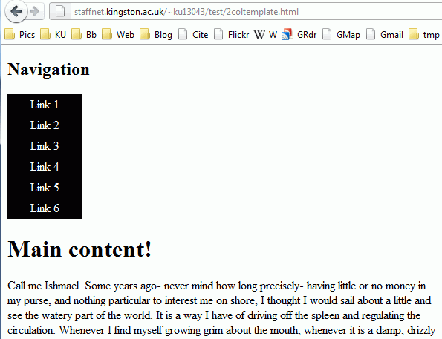
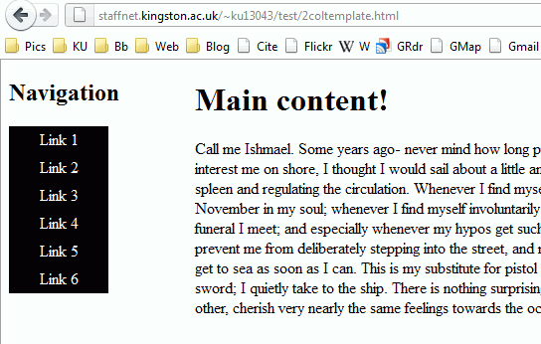
E.g. 2 columns next to each-other?
#nav {width:20%} #main{width:80%}
(url)
Notes:
Edit the CSS in Firefox (Web Developer)

Slide 10
E.g. 2 columns next to each-other?
#main {position:relative;}
#main {position:absolute;}
#nav {position:relative;}
#nav {position:absolute;}
#nav {position:fixed;}
#nav {width:20%} #main{width:80%}
(url)
Notes:
Edit the CSS in Firefox (Web Developer)

Slide 11
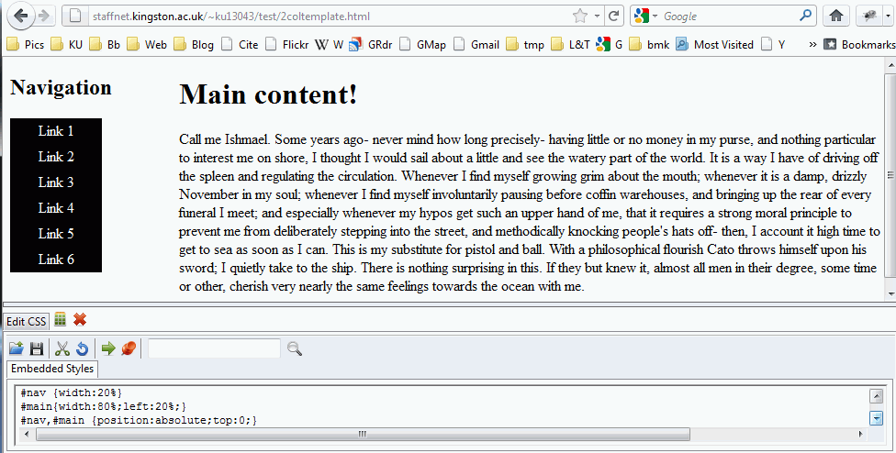
Firefox Web Developer Extension
#nav {width:20%} #main{width:80%}
(url)
Notes:
Edit the CSS in Firefox (Web Developer)

Slide 12
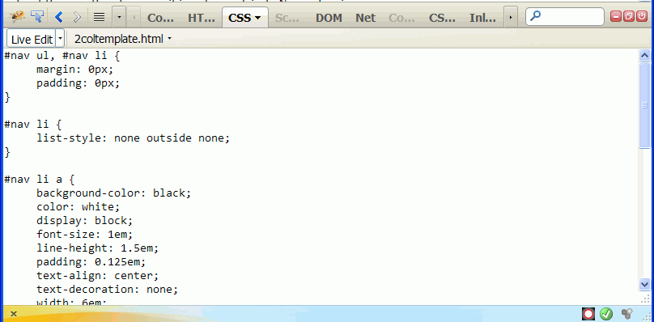
Firefox Firebug Extension
#nav {width:20%} #main{width:80%}
(url)
Notes:
Edit the CSS in Firefox (Web Developer)

Slide 13
XHTML as valid XML documents
XHTML was (eventually) supposed to replace HTML.
Valid XHTML documents are also valid XML documents
(we follow the XML rules)
…as long as the 1st line in the XHTML file is an XML prolog like the following:
<?xml version="1.0" encoding="utf-8"?>
This tells the XML parser a few things about the document and is mandatory for an XML document
… but browsers are not XML parsers & the XML prolog is optional in XHTML!
This is the XML document encoding. We use a META tag.

Slide 14
So what?
We don't have to bother about it as current browsers except Opera and Mozilla don’t understand XHTML as XML!
Serve an XHTML document as an XML ‘MIME type’ to Internet Explorer < IE9 and it chokes! But IE9 is OK ☺
The ‘MIME type’ (or HTTP header ‘Content Type’) tells the browser what kind of document it is
HTML4 and HTML5 is ‘text/html’ (url)
XML is ‘application/xml’ (url)
XHTML is ‘application/xhtml+xml’ (url)
Pre-HTML5, see ‘XHTML considered harmful’
“XHTML5” (HTML5 in XML syntax) also uses XML or XHTML ‘MIME type’

Slide 15
So???
Internet Explorer also switches out of ‘standards mode’ when an XML prolog is present.
It’s in ‘standards mode’ only if a valid DOCTYPE is the 1st line of the document.
See ‘DOCTYPE switching’ online for lots of detail…
IE‘s ‘standards’ vs ‘quirks’ mode affects a few things…
E.g. In the lab last week we saw <table align=“center”> works in IE’s quirks mode but CSS table {margin:auto;} in standards mode.
You really want ‘standards’ mode for consistency & ease of development.
Make sure the 1st line of any (X)HTML document is always a valid DOCTYPE

Slide 16
On a scale of 1 to 5, how much progress do you feel you’ve made with the module?
Virtually no progress: I know nothing new and have remembered little
Some progress: I've learnt or remembered something
OK: I'm making steady progress
Good: I've learnt something and feel comfortable so-far
Excellent: I've learnt and remembered a lot
Notes:
1to5progress.ppv

Slide 17
This is the new stuff..
JavaScript

Slide 18
Introducing JavaScript
Loosely-typed language:
Interpreter converts to/from various types automagically.
Object-oriented but not Java
Methods and prototypes ≠ Classes
JS objects can be created at runtime :-) unlike Java classes…
‘dot’ (.) operator for object ‘properties’ ☺ just like Java
An ECMA standard (ECMA-262 ‘ECMAScript’)
Notes:
The JS interpreter converts types on the fly, e.g. numbers convert to strings automatically when printed. This has important consequences when doing comparing different data types… (of which more later)
JS1.2 quirks:
Array.toString() returns an array constructor (string)
Equality (==) is actually identity (===)
Array(n) returns [n] not an empty array of length n
String.substring() doesn’t work backwards
String.split() removes whitespace first if the split char is a space.

Slide 19
The <script> Element
JavaScript programs
run from within a Web page (either an HTML or XHTML document),
code is typed directly into the source (HTML) file or a separate text file,
contained within a Web page are often called scripts.
The <script> tag tells the web browser that the scripting engine must interpret the commands it contains
The element’s contents are the code or src points to a separate file.

Slide 20
Internal JavaScript <script>
The type attribute of the <script> element
Tells browser which scripting language is being used.
type="text/javascript" says the script is JavaScript.
This HTML tells the web browser to interpret JavaScript:
<script type="text/javascript">
…statements
</script>
The script is not visible on the page.
language="javascript" is deprecated from XHTML1 onwards etc. Don’t use it!

Slide 21
External file <script>
The src attribute of the <script> element
Tells browser where to find an external script file.
<script type="text/javascript" src="script.js" >
statements are ignored!
</script>
The element contents are ignored, the attribute points to the file and that is loaded & parsed as if the code were statements inside a <script> element.

Slide 22
Hello world! (url jsfiddle)
<!DOCTYPE html PUBLIC "-//W3C//DTD XHTML 1.0 Transitional//EN" "http://www.w3.org/TR/xhtml1/DTD/xhtml1-transitional.dtd">
<html>
<head>
<meta http-equiv="Content-Type" content="text/html; charset=iso-8859-1" />
<title>JavaScript "Hello World!"</title>
</head>
<body>
<script type="text/javascript">
document.write("Hello world!");
</script>
</body>
</html>

Slide 23
JavaScript: Numbers
64bit IEEE-754 numbers (cf Java double) floats used for both reals and integers
INT ±2⁵³ ≈ ± 9×10¹⁵ can be represented precisely
REAL ~ ±10³⁰⁸ to ±10⁻³²⁴ are represented approximately
Base 10 assumed unless:
Hexadecimal 0xhhhh or 0Xhhhh for hex digits (h) [0-9] and [a-f] or [A-F]
Conversion from number n to base b string representation by n.toString(b)
Numbers are ‘primitive types’ passed by value (or copy) rather than by reference (more later…)
Notes:
The JS interpreter converts types on the fly, e.g. numbers convert to strings automatically when printed. This has important consequences when comparing different data types… (of which more later)

Slide 24
JavaScript: Strings
Unicode strings either "…" or '…'
No difference, so adopt a style that is best for writing HTML, E.g.
document.write("<p name="fred">")
document.write('<p name='fred'>')
document.write('<p name="fred">')
document.write("<p name='fred'>")
\ is the ‘escape character’ (c.f. C, Java, etc)
E.g. "<p name=\"fred\">"
Also: \uhhhh Unicode character (hex) e.g. \u20ac for € \xhh Latin-1 character (hex) e.g. \xa9 for © \\ literal \ character \n newline … and there are others

Slide 25
JavaScript: Joining strings
Can’t be changed
Strings are immutable so it’s irrelevant whether they’re passed by value/reference.
You can’t change a string value, just create a new string.
E.g. string1 = string1 + string2; (concatenation)
Conversion is done automatically:
E.g. string2 = string1 + number1; string2 = string1 + boolean1;
… this calls the Number or Boolean object's toString() method.

Slide 26
In JavaScript, what does this produce? "It's " + 2010
An error.
“It's 2010”
Whatever is ASCII “It's” + 2010
The variable It's plus 2010

Slide 27
JavaScript: String objects
Strings may be immutable but they are objects:
string.length number of chars.
string.charAt(n) n^{th} character
string.substr(start,length) string.substring(from,to)
string.indexOf('substring'[,from]) find a substring
string.toLowerCase() sim. toUpperCase
To convert strings to numbers (if possible) use
parseFloat(s) and parseInt(s) return numbers or ‘NaN’
return a substring
Notes:
Strings are indexed from zero.
The two variants of ‘substring’ allow selection of a fixed length string either from a starting position, forward a number of char’s, or from a one fixed point to another.
indexOf takes an optional argument ‘from’ to enable repeatedly searching for substrings - we’ll cover more powerful ‘regular expression’ searches in the next couple of weeks.
Upper and lower case conversion are for [a-z] -> [A-Z] only. Full Unicode conversion, including international characters [Turkish!] is done with toLocaleUpperCase etc.
Converting a string to a number (if possible) is done with the parseInt/Float functions - they’ll happily ignore any non-numerical chars after a numerical part (but not before).
NaN is a reserved word that means ‘not a number’ (it’s actually a property of the root object, usually window in client-side JavaScript) which 0/0 also returns. It can be checked for with the isNaN() function. A similar ‘number’ is infinity with its companion function isInfinity() (+/- 1/0). A third property is undefined which is the state, e.g., array elements are in before they’re populated … it’s important as it’s also the value you get when checking for an undefined object property … more of which next week when we consider equality.

Slide 28
JavaScript Objects
JavaScript is an “object-based” programming language
An object
Programming code and data that can be treated as individual unit or component
A method
Procedures associated with an object
A property
Piece of data, such as a color or a name that is associated with an object

Slide 29
JavaScript Objects (Cont.)
To use an object and associated method in JavaScript code:
Type the object’s name, followed by a dot (full stop “.”), followed by the method name
objectName.methodName1()
Many methods need to be provided with more specific information, called an argument, between parentheses
objectName.methodName2(arg1, arg2, ...)
Some methods require numerous arguments, while others don’t require any
Providing an argument for a method is referred to as passing arguments … revise it!

Slide 30
Introducing JavaScript Reference types: Objects
Objects
Can be indexed associatively E.g. object.property or object['property']
Object() is the constructor function from which methods are inherited and/or assigned and in which static methods can be defined.
More about objects and functions next week!
Notes:
The most important thing to remember is object.property
Also (for fun?!) read up on prototype…

Slide 31
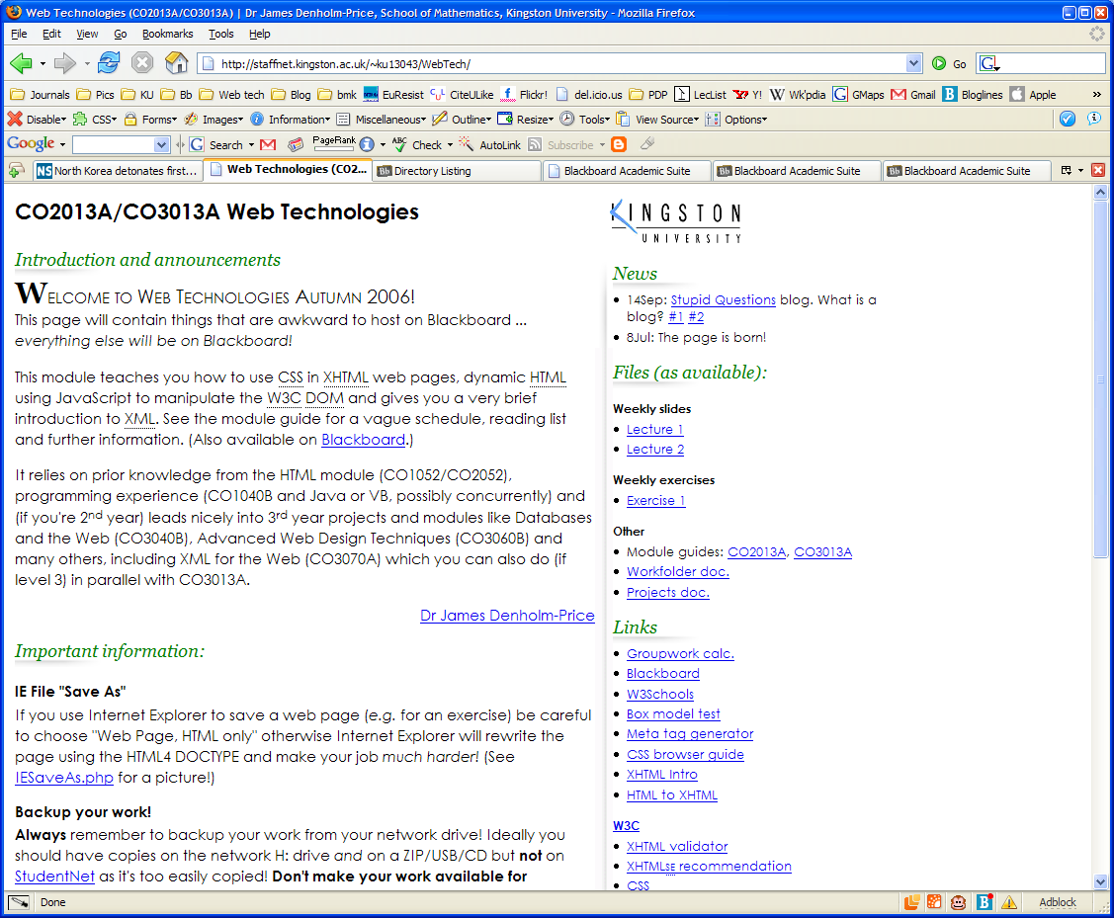
The Browser Object Model
BOM
Notes:
Since IE4/NS4, browsers have represented an HTML document as a tree structure of objects, ‘rooted’ at the window (as the top level object – in fact in client-side JavaScript it is the top-level object [in the JS lexical scope tree] … each browser window therefore has a separate scope)
The window object has properties that refer to its parent (usually self, but one can open a new window under JS control!), itself (a synonym for window) and top which is a reference to the current top (browser) window.
Location contains info. about the current URL, such as location.href
History is an array of history URLs with methods for moving within the list.
Navigator provides info about the browser (we’ll be using it in the first exercise)
Frames indexes the document objects residing in each subframe (nested documents)
Screen
Document is the root of the current HTML document which in DOM0 provides arrays of embedded applets, images, links, anchors and forms (and the forms array allows access to the elements in each form)

Slide 32
The document object and write() method
document object
one of the most commonly used objects in JavaScript programming,
represents content of a browser window or frame.
Provides a simple way to create new elements as a page loads:
use the write() method or the writeln() method of the document object
document.write('<p>Stuff and nonsense...</p>');
Stuff is added to the page while it is being rendered.
We’ll learn neater, more object-oriented ways to do this when we explore the DOM (document object model.)
This doesn’t work in “strict XHTML” mode (i.e. XML.)

Slide 33
Using the write() method
the write(argument) method
Requires a text string (or something that can be converted to one) as its argument(s)
Performs essentially the same function that is performed when a text is manually added to the body of a standard Web page document
Remember that JavaScript treats "…" and '...' strings the same.

Slide 34
Example (url)
<!DOCTYPE html PUBLIC "-//W3C//DTD XHTML 1.0 Transitional//EN" … >
<html>
<head>
<title>Example</title>
</head>
<body>
<script type="text/javascript">
document.write('<h1>Hello World!</h1>');
document.writeln("<p>This is all made up!</p>"); </script>
</body>
</html>
These write into the document object model (tree) as if the tags were part of the HTML source here…

Slide 35
Before <script> executes
<html>
documentElement
<head> <title>Example</title>
</head>
<html>
<head>
<body>
<body>
<title>
<script>
<script>…</script>
'Example'
'document…'
</body>
</html>
Notes:
The top of the tree is the documentElement node – this is a DOM element that represents the document object.
Each HTML tag has an element node associated with it.
Each piece of text has a text node whose value is the text itself.
NB: textNodes do not have children!
All nodes are objects in the DOM – they're all accessible & manipulable (to varying degrees) so they all have properties and methods.

Slide 36
After <script> executes
<html>
documentElement
<head> <title>Example</title>
</head>
<html>
<head>
<body>
<body>
<title>
<script>
<h1>
<p>
<script>…</script>
<h1>Hello…</h1> <p>This is…</p>
'Example'
'document…'
'Hello…'
'This…'
</body>
</html>
Notes:
The top of the tree is the documentElement node – this is a DOM element that represents the document object.
Each HTML tag has an element node associated with it.
Each piece of text has a text node whose value is the text itself.
NB: textNodes do not have children!
All nodes are objects in the DOM – they're all accessible & manipulable (to varying degrees) so they all have properties and methods.

Slide 37
Sort of like this:
<!DOCTYPE html PUBLIC ...>
<html>
<head>
<title>Example</title>
</head>
<body>
<script type="text/javascript">
document.write('<h1>Hello World!</h1>');
document.writeln('<p>This is all made up!</p>'); </script>
</body>
</html>
<h1>Hello World!</h1>
<p>This is all made up!</p>

Slide 38
Window and Document methods
window is the object that all other objects inherit properties from
Useful objects/methods (all string args, s):
alert(s) popup alert dialog
Modal popup dialog (most systems)
Also confirm and prompt.
document is a property of window and contains the document contents in a series of objects & methods
document.write(s)
Writes s into the document as it loads
Notes:
The window object is, in client-side JS, the top level object I.e. it's at the top of the lexical scope tree wherever the tree starts.
This means that the window.alert method, for example, can usually be called as a function alert()
But if a function is defined as alert() in the scope tree used by the current context it's found first and so window.alert() is not called.
All this means is that sometimes it's necessary to be careful how you access methods!
E.g. we usually do document.write(), hardly ever window.document.write()

Slide 39
Introducing JavaScript
JavaScript is case sensitive!
var foo is not Foo, fOo, foO, FOo, FoO or FOO !
Statements should be terminated with a ; (semicolon)
Variable assignment with var
creates a local variable (avoids scope problems)
except at top level (adjacent to <script>) where it’s global.
var foo = new Object();
function bar(o) { //function to return a string return o.toString(); } alert("Object's string is " + bar(foo) );
Notes:
The JS interpreter converts types on the fly, e.g. numbers convert to strings automatically when printed. This has important consequences when doing comparing different data types… (of which more later)
Use of ; is formally optional but not here - I want you to get used to using the ; as
it makes the code easier to read (syntax highlighting editors like it, too)
it's slightly safer when coding
other languages you might come across (e.g. PHP) insist upon it, so why not develop good practice now!
The var operator defines a 'local' variable. JS's 'lexical scope' (it searches in a tree for identifiers) means that top-level 'var' assignments are global but it makes function assignments local which is a good thing!! (Good programming practice - otherwise functions end up with unforeseen side effects) More on scope next week (or maybe the week after…)

Slide 40
JavaScript <script> & comments
Insert inline JavaScript into HTML pages like: <script type="text/javascript"> //a comment - alert pops up a dialog box alert('Hello world!'); /* another comment */ //now write the same thing into the HTML document.write('<p>Hello world!</p>'); </script>
Notes:
The <script> block contains the JavaScript code.
Three comments supported:
<!-- for compatibility with HTML - only used in one context
// for single line (commented text to end of line)
/* … */ comments between - includes multiline.

Slide 41
Placing JavaScript code in a web page
<script> tags are interpreted as the page loads:
<head>
Define functions here.
E.g. could use document.write to set style sheets dynamically
document.write('<link rel="stylesheet" href="…" />');
<body>
Can use document.write to write into the page
E.g. document.write(today.toTimeString());
Notes:
Coding style:
keep ‘static’ stuff (functions, global vars etc) in the <head>
‘dynamic’ stuff exists within the page, calls functions from the head
<body onload> used to set-up initial state … elements are guaranteed to exist when this event is called

Slide 42
Commenting out inline JavaScript
The old way of hiding code from old browsers <!-- document.write('<h1>Hello World!</h1>'); //-->
The new, just-as-ugly, XHTML-compliant method: <!--<![CDATA[ document.write('<h1>Hello World!</h1>'); //]]>-->
There are no browsers that don’t understand <script> so we can neglect the “hide code from old browser” comment tags … most of the time ;-)
When not?
Validation! Tags in JS may confuse the validator.
Use an external <script src=“...”></script> for 100% validation.
Notes:
In practice it's often easier to include the code from a file using the src attribute of <script> This also gets around a few 'problems':
XML parsers might parse certain strings (< & [[ )
XML parsers can drop comments completely - the source might never get passed to the JS interpreter (just an empty block!)
W3C's validator (and others, presumably) doesn't ignore JS comment blocks properly so invalid HTML can arise if there are any 'open tag' symbols/less than < signs in the code.

Slide 43
Commenting out inline JavaScript
When to use comments: Validation! E.g.
<script type="text/javascript"> document.write('<div>',todaysDate,'</div>'); </script>
May fail to validate because of the <div> even though that’s in the JavaScript language block and so should be ignored…
Avoid it! Use an external JS file <script src="…">
Fix it with …
Transitional:
<script type="text/javascript"> <!-- document.write('<div>',todaysDate,'</div>'); --> </script>
Strict (yuck!):
<script type="text/javascript"> <!--<![CDATA[ document.write('<div>',todaysDate,'</div>'); //]]>--> </script>
… strictly ;-) Strict XHTML disallows document.write et al…

Slide 44
JavaScript & validator problems
Best complete workaround: src attribute
The JavaScript source is in a separate file so the validator never sees it (NB: Just the JS statements, not the HTML <script> tag)
<script type="text/javascript" src="../myscripts/script1.js"> </script>
This is the best way of separating complex JS from HTML
The browser loads them separately/concurrently
Non-JS browsers don't load the code at all (reduce b/w)!
Can use <noscript>…</noscript> as backup.
Notes:
Technically the W3C validator ought to ignore JavaScript that has been HTML commented (for HTML4 DOCTYPEs) or XML commented (for XHTML), but it doesn't and this can mess up an otherwise valid page!
A workaround is to break up the strings containing tags to fool the validator into ignoring the tags.
An alternative (annoying for really small scripts) is to have everything in external files … this seems to be the strict interpretation of W3C XHMTL guidelines but seems to be an oversight - the CDATA comments ought to sort it out (if the validator was a proper XML parser!)

Slide 45
JavaScript & <noscript>
If your JavaScript creates structure in the HTML it's a good idea to include a <noscript> block that will fix the document in case the browser has JavaScript disabled:
(10-20% on the stat's list had JS disabled!)
Web crawlers don’t (usually) … you do want to get indexed, don’t you?
<script type="text/javascript">
document.write('<div>',todaysDate,'</div>');
</script>
<noscript>
<div class="noJS">JavaScript disabled!</div>
</noscript>
Notes:
The use of the <noscript> block might seem anachronistic (every modern browser supports JS, surely?) However
Web crawlers don't - you do want to get indexed by search engines, don't you?
The text-based browser Lynx doesn't (and nor do most mobile phones, for example)
JS is often disabled for security (JS virus!) … your page might render badly without the <noscript> structure (mine did!)

Slide 46
Example
<!DOCTYPE html PUBLIC ... >
<html>
<head>
<title>Example</title>
</head>
<body>
<script type="text/javascript">
document.write('<h1>Today’s date</h1>');
document.writeln('<p>' + todaysDate + '</p>'); </script>
<noscript>
To see this page fully, please enable JavaScript.
</noscript>
</body>
</html>
These write into the document object model (tree) as if the tags were part of the HTML source here…

Slide 47
Fix the validator with basic comments
<!DOCTYPE html PUBLIC ... >
<html>
<head>
<title>Example</title>
</head>
<body>
<script type="text/javascript">
<!--
document.write('<h1>Today’s date</h1>');
document.writeln('<p>' + todaysDate + '</p>');
//--> </script>
<noscript>
To see this page, please enable JavaScript.
</noscript>
</body>
</html>

Slide 48
Fix the validator for XHTML-as-XML
<!DOCTYPE html PUBLIC ... >
<html>
<head>
<title>Example</title>
</head>
<body>
<script type="text/javascript">
<!--<![CDATA[
document.write('<h1>Today’s date</h1>');
document.writeln('<p>' + todaysDate + '</p>');
//]]>--> </script>
<noscript>
To see this page, please enable JavaScript.
</noscript>
</body>
</html>

Slide 49
Fix the validator with external JS
<!DOCTYPE html PUBLIC ... >
<html xmlns="...">
<head>
<title>Example</title>
</head>
<body>
<script type="text/javascript" src="file.js"></script>
<noscript>
To see this page, please enable JavaScript.
</noscript>
</body>
</html>
“file.js” contains the code only (just 2 lines here):
document.write('<h1>Today’s date</h1>');
document.writeln('<p>' + todaysDate + '</p>');

Slide 50
Introducing JavaScript: Date
var newdate = new Date();
newdate contains a Date object with the current date and time
var newdate = new Date(year,month,day, hour,min,sec,ms);
All but year, month & day are optional (from the right)
Date(year, month, day [, hour, [min, [sec, [ms]]]]);
var newdate = new Date(milliseconds);
ms since 1st Jan 1970 (Unix epoch) - argument is a number
var newdate = new Date('date string');
Parses ‘date string’ according to Date.parse() which is a static Date method.
Format is not standardised by ECMA but the formats used by Date.toString() and Date.toUTCString() are recognised …

Slide 51
Introducing JavaScript: Date
Date var newdate = new Date(); current date and time = new Date(y,m,d,h,min,s,ms); = new Date(milliseconds); ms since 1st Jan 1970 (Unix) = new Date('date string');
Methods:
newdate.getDate() day of month newdate.getDay() day of week newdate.getFullYear() yyyy newdate.getMonth() month newdate.get{Hours,Minutes,Seconds}() newdate.toDateString() newdate.toTimeString() newdate.toLocaleString() newdate.valueOf() Unix system time (ms)
UTC variants,
like
getUTCHour()
implementation-specific
output – see exercise

Slide 52
Date Year and “Y2k”
The getYear method is not Y2k-compliant, and running new Date().getYear() in 2005 may return "105" because getYear() returns the year minus 1900…
getYear was deprecated in ECMAScript Version 3 and replaced with getFullYear().
Internet Explorer changed getYear to work like getFullYear() and make it Y2k-compliant, while Mozilla kept the standard behaviour.

Slide 53
Example (url)
<!DOCTYPE html PUBLIC "-//W3C//DTD XHTML 1.0 Transitional//EN" "http://www.w3.org/TR/xhtml1/DTD/xhtml1-transitional.dtd">
<html>
<head><title>Example</title></head>
<body>
<p>
<script type="text/javascript">
var now = new Date(); document.write("It's" + now.getYear() + "!");
</script>
</p>
</body></html>

Slide 54
Aside
Quick project discussion…

Slide 55
Project
Stage 1: Drawing the board
Use a table for simplicity
So each tile is a <td>
Or
<div> and CSS float ;-)
So each tile is a <div>
Easy to identify each cell with an ID or collect them together in an array and count columns & rows…

Slide 56
Example: Chessboard
<script type="text/javascript">
document.write('<table id="chessboard">');
var colour = 'white';
for (var row=0; row<8; row++) {
document.write('<tr>');
for (var col=0; col<8; col++) {
document.write('<td class="');
document.write(colour . '">');
document.write('">');
document.write('&nbsp;</td>');
if (colour=='white') colour='black';
else colour='white';
}
document.write('</tr>');
if (colour=='white') colour='black'; else colour='white';
}
document.write('</table>');
</script>
(url)

Slide 57
Chessboard: shorter code
Replace:
document.write('<td class="');
document.write(colour>');
document.write('">');
document.write('&nbsp;</td>');
with one statement:
document.write( '<td class="', colour, '">', '">', '&nbsp;</td>' );
Use a ternary operator for quick if-test assignments:
if (colour=='white')colour='black'; else colour='white';
colour = (colour=='white')?'black':'white';

Slide 58
Chessboard
Identifying the cells using the id attribute:
document.write('<td ', 'id="r', row, 'c', col, '">');
document.write('&nbsp;</td>');
Gives us cells like
<td id="r1c1">&nbsp;</td>
<td id="r1c2">&nbsp;</td>
/* ... Etc ...*/
<td id="r8c1">&nbsp;</td> /* etc. */
Use CSS to set the tiles' height & width and the &nbsp; is entirely unnecessary…

Slide 59
Back to JavaScript
for loops

Slide 60
JavaScript for loops
Easiest illustrated with an example:
for (var i=0; i<10; i++) {
document.write('<p>Hi!</p>')
}
initialise “i=0”
test “i<10?”
increment “i=i+1”
(url)

Slide 61
Example
Write some JavaScript to put five table rows each with one cell into a page…
Use the document.write method inside a loop
for (var i=1; i<=5; i++) {
document.write('<tr><td>'); //open row & cell
document.write('Cell '+i); //write text
document.write('</td></tr>'); //close cell & row
}
(url)

Slide 62
Exercise: Write some JavaScript to put five table rows each with five columns into a page… Use the document.write method How many for loops to do 5 rows by 5 columns?
One
Two
Three
Four
Five
Ten
Twenty-five
No idea!

Slide 63
Exercise
Write some JavaScript to put five table rows each with five columns into a page…
Use the document.write method
for (var i=0; i<5; i++) {
document.write('<tr>');
for (var j=0; j<5; j++) {
document.write('<td>' + i + ',' + j + '</td>');
}
document.write('</tr>');
}

Slide 64
5x5
<table>
<tr>
<td>1</td> <td>2</td> <td>3</td> <td>4</td> <td>5</td> </tr>
<tr>
<td>1</td> <td>2</td> <td>3</td> <td>4</td> <td>5</td> </tr>
<tr>
<td>1</td> <td>2</td> <td>3</td> <td>4</td> <td>5</td> </tr>
<tr>
<td>1</td> <td>2</td> <td>3</td> <td>4</td> <td>5</td> </tr>
<tr>
<td>1</td> <td>2</td> <td>3</td> <td>4</td> <td>5</td> </tr>
</table>

Slide 65
JavaScript
Probably next week ;-)

Slide 66
JavaScript while loops
while (condition) {
statement
}
i=0;
while (i<10) {
document.write('<p>Hi!</p>');
i++;
}
increment operator “i=i+1”

Slide 67
JavaScript do loops
do {
statement
} while (condition);
i=0;
do {
document.write('<p>Boo!</p>');
i++;
} while (i<10);
increment operator “i=i+1”

Slide 68
while/do…while: Difference? No!
i=0;
while (i<10) {
document.write('<p>Hi!</p>')
i++;
}
i=0;
do {
document.write('<p>Boo!</p>')
i++;
} while (i<10);
URL

Slide 69
while/do…while: Difference? Yes!
i=100;
while (i<10) {
document.write('<p>Hi!</p>')
i++;
}
i=100;
do {
document.write('<p>Boo!</p>')
i++;
} while (i<10);
URL

Slide 70
This week: JavaScript
“JavaScript for the WWW”
Chapters 1—3 + 10 (DOM: 7e=ch. 11)
“Head First JavaScript”
Chapters 1—2 + 3—5
“Learning JavaScript”
Chapters 1—3 + 9—10
Or
Gosselin “JavaScript 3e”
Ch1 introduces JS, Ch2 introduces JS variables etc.
“JavaScript A programmer’s companion”
chapters 1~5.
ETC…

Slide 71
Next week
JavaScript:
Functions
HTML:
Events.

